Slide 1

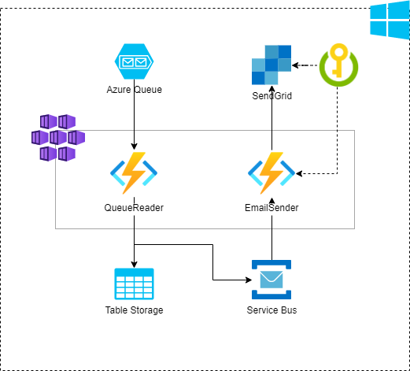

Architecture Sample

Slide 2
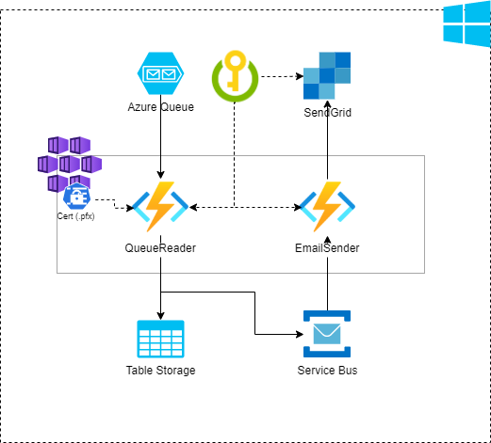
Architecture Sample (Kubernetes/AKS Deploy)

Slide 3
